Slide 1
Sales Dashboard Summary
Power BI Report | 2025
Made By: Arya Dalvi

Slide 2
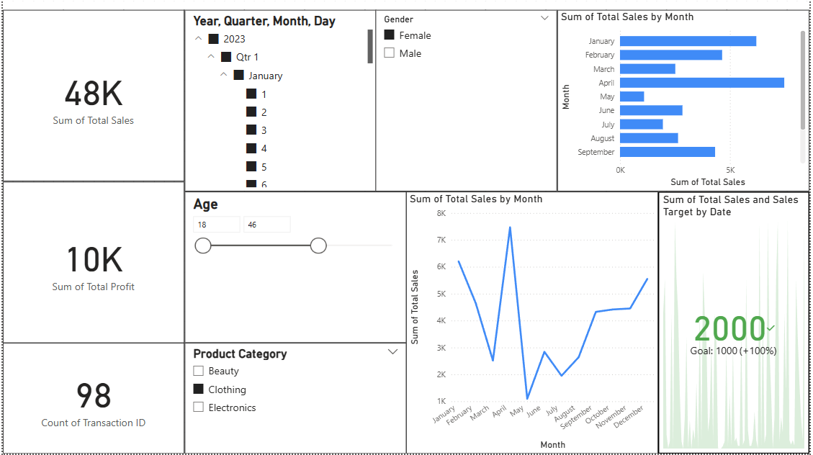
Dashboard Overview

Slide 3
KPIs and Insights
- Total Sales: 48K
- Total Profit: 10K
- Transactions: 98
- Sales peaked in April
- Sharp drop in June, recovery began from July

Slide 4
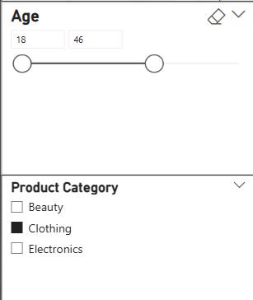
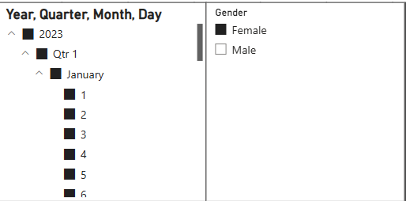
Interactive Features
- Slicers: Time (Year, Month, Day), Gender, Age, Product Category
- Dynamic filtering by age range and customer gender
- Trend analysis by month

Slide 5
Business Recommendations
- Focus marketing on months with low sales (e.g., June)
Identify months with consistently low sales (e.g., June) using time-series visuals.
Run targeted promotions and campaigns during these periods to boost engagement.
Consider seasonality trends by comparing sales year-over-year.
- Investigate performance of product categories
- Analyze impact of age and gender on sales trends
📈 High-sales, low-profit categories → optimize pricing
📉 Low-sales, high-profit categories → boost visibility and promotion

Slide 6
Thank You!

